Slide 1

Banking Database Management System
SQL DATABASE PROJECT
BankingDB
Team Members
Ch . Pavan kalyan
T. Revanth Ram kumar
B. Praveeth sai

Slide 2



Problem Statement
Banks need one reliable system to store customers, accounts and transactions.
Scattered Records
Manual Errors
Slow Insights
Data spread across files and sheets
Wrong balances and duplicate entries
Hard to track branch and account activity

Slide 3



Project Outcome
5
10
15
30
Tables
Customers
Accounts
Transactions
Structured, rule-based database
34 SQL tasks: queries, view, procedures, triggers
Reliable balance and transaction tracking

Slide 4
Database Design
Branches
branch_id | PK
branch_name
location
ifsc_code
Customers
customer_id | PK
customer_name
phone
email
address
Account_Types
account_type_id | PK
account_type_name
Accounts
account_id | PK
branch_id | FK
customer_id | FK
account_type_id | FK
account_number
balance
opening_date
status
Transactions
transaction_id | PK
account_id | FK
transaction_type
amount
transaction_date
description
PK Primary Key FK Foreign Key

Slide 5
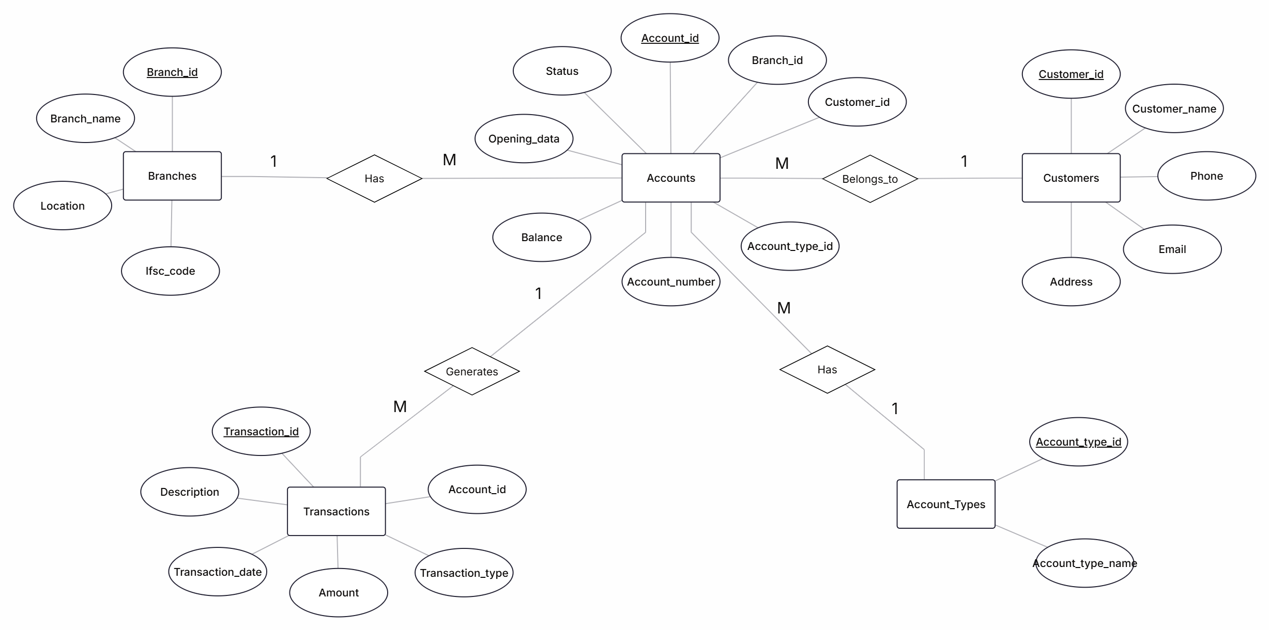
ER Diagram

Slide 6


Data Integrity with Constraints
Primary & Foreign Keys
Link every table reliably
SQL
CREATE TABLE Accounts (
account_id INT PRIMARY KEY,
account_number VARCHAR(20)
UNIQUE NOT NULL,
balance DECIMAL(12,2) DEFAULT 0.00,
FOREIGN KEY (branch_id)
REFERENCES Branches(branch_id),
CHECK (balance >= 0)
);
CHECK Rules
Balance ≥ 0, valid status and type
UNIQUE & NOT NULL
No duplicate account numbers
Invalid data is rejected by the database itself

Slide 7



Joins: Connecting Tables
INNER JOIN
Customers, accounts and types
SQL
SELECT c.customer_name,
a.account_number,
at.account_type_name
FROM Customers c
JOIN Accounts a
ON c.customer_id = a.customer_id
JOIN Account_Types at
ON a.account_type_id = at.account_type_id;
LEFT JOIN
Keeps customers with no accounts
Branch Details
Account number with branch and city
One readable view of customer, account and type

Slide 8
Aggregate Functions
₹10,57,000
₹1,50,000
₹18,000
₹70,466.67
Total balance
Highest balance
Lowest balance
Average balance
SQL
Deposits vs Withdrawals
SELECT SUM(balance) AS total_balance,
MAX(balance) AS highest_balance,
MIN(balance) AS lowest_balance,
ROUND(AVG(balance), 2) AS average_balance
FROM Accounts;
₹2,35,000
each, using CASE WHEN

Slide 9



String Functions
CONCAT()
Joins name and account number
SQL
SELECT CONCAT(c.customer_name, ' - ',
a.account_number)
AS customer_account,
UPPER(c.customer_name)
AS customer_name_upper
FROM Customers c
JOIN Accounts a
ON c.customer_id = a.customer_id;
UPPER()
Customer names in capital letters
Aliases
Readable column headings with AS
Output format: Aarav - 100000001

Slide 10


Date & Time Functions
YEAR()
Extracts the year from a date
SQL
SELECT YEAR(transaction_date) AS year,
MONTHNAME(transaction_date) AS month,
ROUND(SUM(amount), 2) AS monthly_total
FROM Transactions
GROUP BY YEAR(transaction_date),
MONTH(transaction_date),
MONTHNAME(transaction_date)
ORDER BY MONTH(transaction_date);
MONTHNAME()
Turns month 7 into July
MONTH()
Orders results by calendar month
All 30 transactions fall in July 2025: ₹7,05,000

Slide 11



GROUP BY and HAVING
GROUP BY
Customer count for every branch
SQL
SELECT c.customer_name,
COUNT(a.account_id) AS total_accounts
FROM Customers c
JOIN Accounts a
ON c.customer_id = a.customer_id
GROUP BY c.customer_id, c.customer_name
HAVING COUNT(a.account_id) > 1;
COUNT
Savings vs Current accounts
HAVING
Customers with more than one account
All 5 account holders own 2 or more accounts

Slide 12


Subqueries
Highest Balance
MAX() inside a WHERE clause
SQL
SELECT account_id,
account_number,
balance
FROM Accounts
WHERE balance > (
SELECT AVG(balance)
FROM Accounts
);
Above Average
Compare each balance with AVG()
No Transactions
NOT EXISTS finds idle customers
Highest balance: ₹1,50,000, held by Deepika

Slide 13
Monthly Transaction Summary
SQL
SELECT MONTHNAME(transaction_date) AS month,
COUNT(*) AS txn_count,
SUM(CASE
WHEN transaction_type = 'Deposit'
THEN amount ELSE 0 END) AS deposits
FROM Transactions
GROUP BY MONTH(transaction_date),
MONTHNAME(transaction_date);
30
₹2,35,000
Transactions in July 2025
Deposits
₹2,35,000
₹2,35,000
Withdrawals
Transfers

Slide 14


View: Active Account Details
Virtual Table
A saved query, always up to date
SQL
CREATE OR REPLACE VIEW Active_Account_Details AS
SELECT a.account_number, c.customer_name,
at.account_type_name, a.balance,
b.branch_name, b.ifsc_code
FROM Accounts a
-- JOINs with Customers, Account_Types, Branches
WHERE a.status = 'Active';
4 Tables Joined
Accounts, customers, types, branches
Active Only
Inactive accounts stay hidden
One simple SELECT returns the full account report

Slide 15

Stored Procedure: Transfer_Money
SQL (key lines)
Validates Input
Rejects same account or amount ≤ 0
CREATE PROCEDURE Transfer_Money(
IN p_from_account INT, IN p_to_account INT,
IN p_amount DECIMAL(12,2))
BEGIN
DECLARE v_from_balance DECIMAL(12,2);
DECLARE EXIT HANDLER FOR SQLEXCEPTION
BEGIN ROLLBACK; RESIGNAL; END;
IF p_from_account = p_to_account OR p_amount <= 0 THEN
SIGNAL SQLSTATE '45000'
SET MESSAGE_TEXT = 'Invalid transfer details';
END IF;
START TRANSACTION;
SELECT balance INTO v_from_balance FROM Accounts
WHERE account_id = p_from_account FOR UPDATE;
IF v_from_balance < p_amount THEN
SIGNAL SQLSTATE '45000'
SET MESSAGE_TEXT = 'Insufficient balance';
END IF;
UPDATE Accounts SET balance = balance - p_amount
WHERE account_id = p_from_account;
UPDATE Accounts SET balance = balance + p_amount
WHERE account_id = p_to_account;
COMMIT;
END
Locks the Rows
FOR UPDATE stops conflicting changes
All or Nothing
COMMIT on success, ROLLBACK on error
CALL Transfer_Money(101, 102, 10000.00);
Also: Get_Customer_Accounts(id), Get_Account_Transactions(id)

Slide 16
Triggers
After_Transaction_Insert
AFTER INSERT on transactions
Before_Account_Balance_Update
BEFORE UPDATE on accounts
SQL
SQL
CREATE TRIGGER After_Transaction_Insert
AFTER INSERT ON transactions
FOR EACH ROW
BEGIN
INSERT INTO Transaction_Log (
transaction_id, account_id,
transaction_type, amount,
transaction_date)
VALUES (
NEW.transaction_id, NEW.account_id,
NEW.transaction_type, NEW.amount,
NEW.transaction_date);
END
CREATE TRIGGER Before_Account_Balance_Update
BEFORE UPDATE ON accounts
FOR EACH ROW
BEGIN
IF NEW.balance < 0 THEN
SIGNAL SQLSTATE '45000'
SET MESSAGE_TEXT =
'Error: Account balance cannot be negative';
END IF;
END
Every new transaction is logged automatically
Any update that makes a balance negative is blocked

Slide 17
Thank You
Any Questions?

